Slide 1
Raster method of 2d transformations

Slide 2
It is another method for performing certain 2d transformations
.it is not used for complex transformation and 3d transformations,

Slide 3
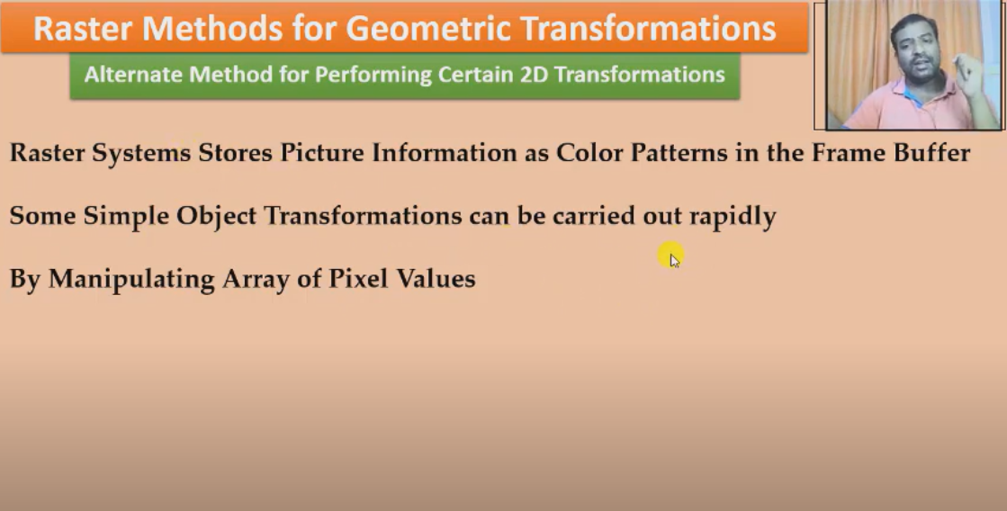

Slide 4
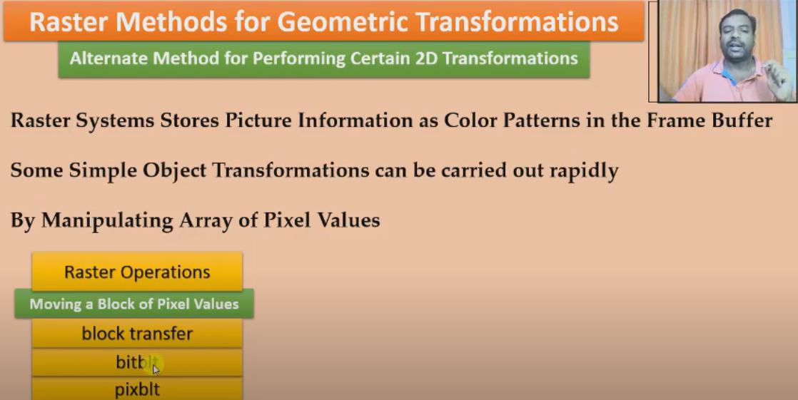
Manipulating array of pixels is also called raster operations.on these block or array of pixels any 2d transformation can be performed

Slide 5
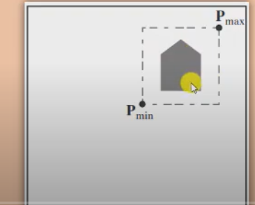
This area covered by the dotted lines will be called as block of pixels and operations will be performed on this area. any transformation can be used on this figure it may be scaling,translation rotation etc. all the information will be stored in the form of array of pixels.

Slide 6
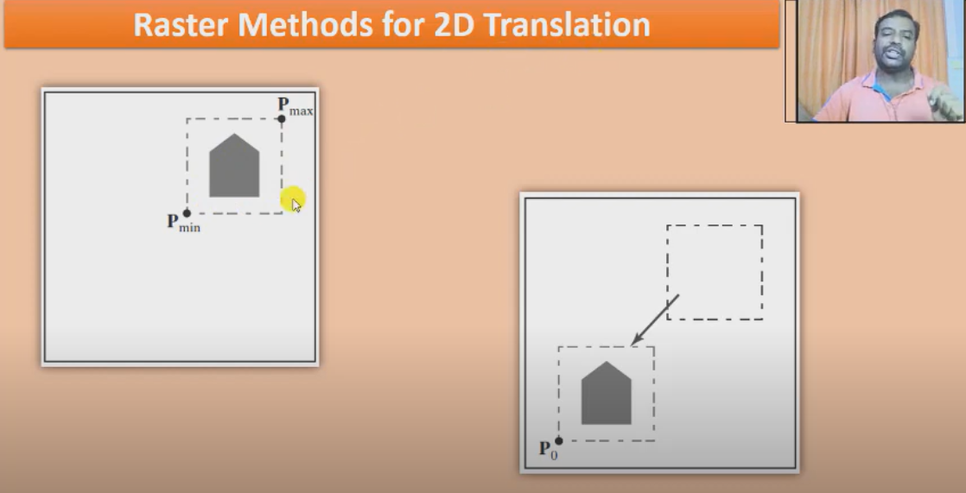
Just copy the pixels and shift the entire pixel information and paste it on the destination points
and original pixels are changed to the background color assuming there is no overlapping .
this is how translation can be achieved in raster method technique.

Slide 7
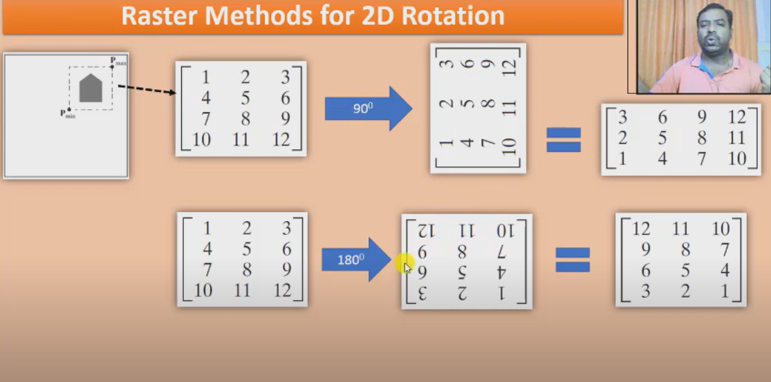
This information is copied to an array (each pixel has a value) this array has 12 information .
If i rotate this information by 90degree.this is the new matrix after applying 90 degree rotation.
similarly on roatating by 180 degree I get the ff matrix. Either I use the transpose or flip the matrix this technique works for multiple of 90 degree
for any other angle this technique does not work.
if the angleof rotation is 45 by just seeing what pixel is overlapping after rotation a decision is made for keeping the color or changing color by copying the color of the background

Slide 8
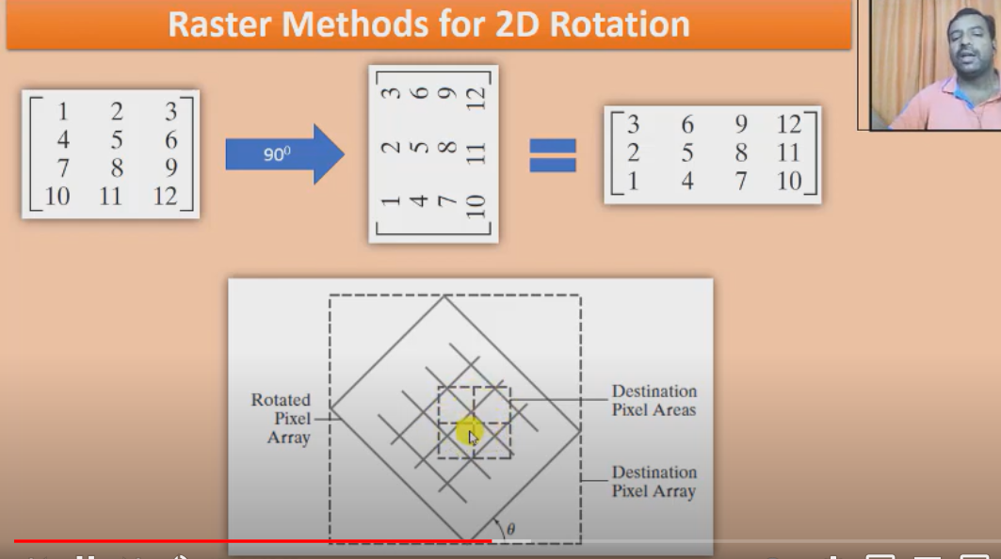

Slide 9
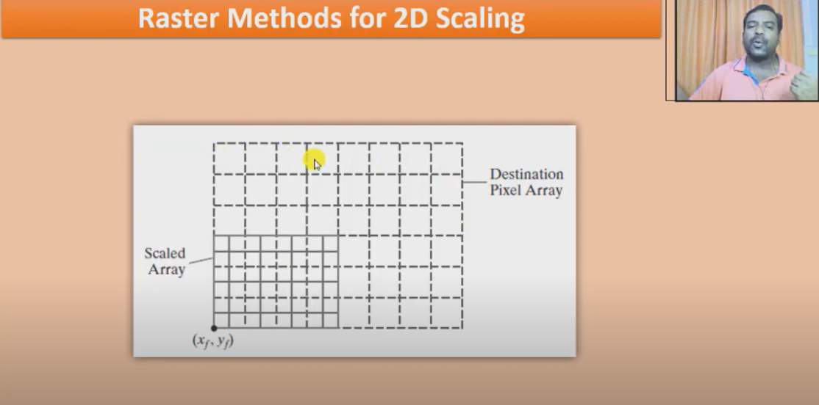
If the size of the pixel is to be reduced by half in scaling the destination array of pixels is reduced to half
so now we will look for overlapping .the color is matched if one block is the original and the other which is reduced
so in case of ovelapping we change the background color.

Slide 10
